Slide 1
Chongqing University of Technology
ATAI
Advanced Technique of Artificial Intelligence
Chongqing Unive
Zero-Shot Stance Detection via Contrastive Learning
（WWW-2022)
Code : https://github.com/HITSZ-HLT/PT-HCL
Reported by Zhaoze Gao

Slide 2
Chongqing University of Technology
ATAI
Advanced Technique of Artificial Intelligence
Chongqing University of Technology
1. Introduction
2. Approach
3. Experiments

Slide 3
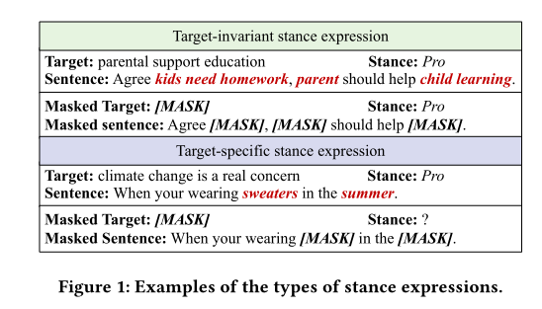
Introduction

Slide 4
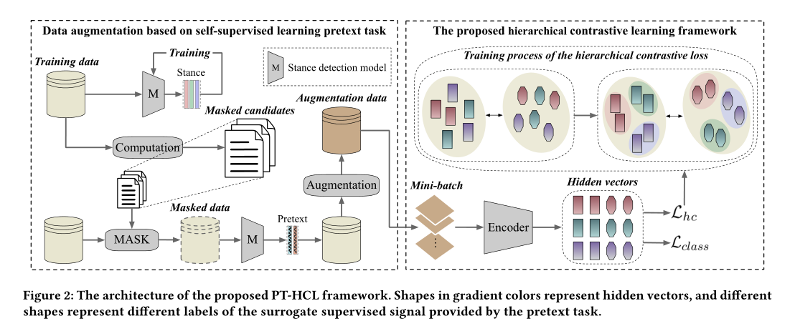
Approach

Slide 5
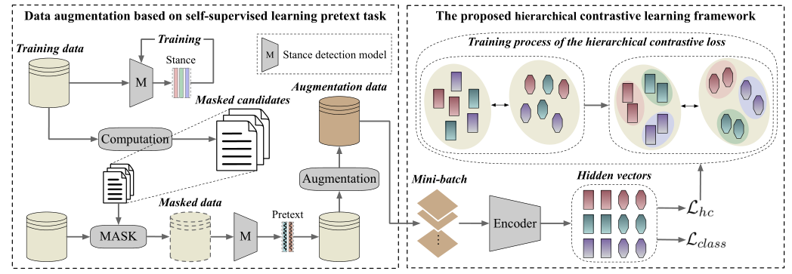
Approach

Slide 6
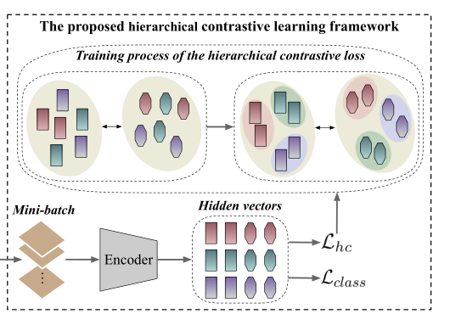
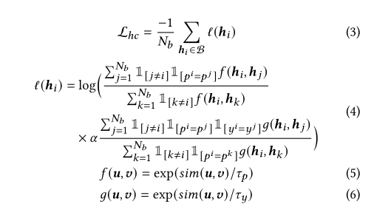
Approach

Slide 7
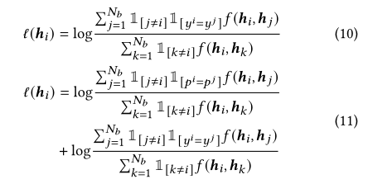
Approach

Slide 8
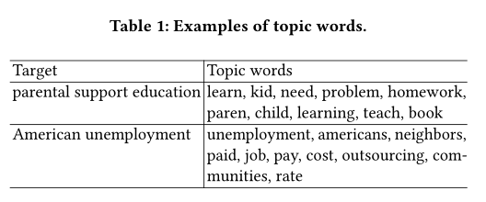
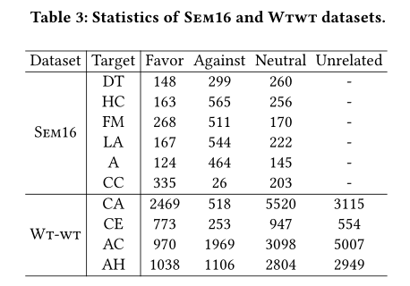
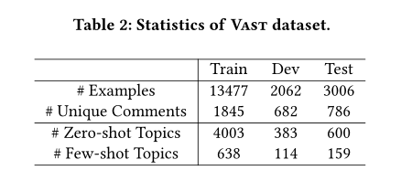
Experiments

Slide 9
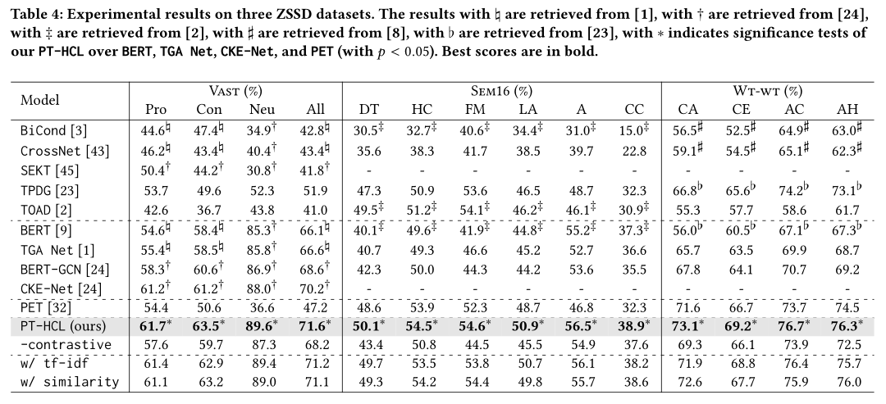
Experiments

Slide 10
Experiments

Slide 11
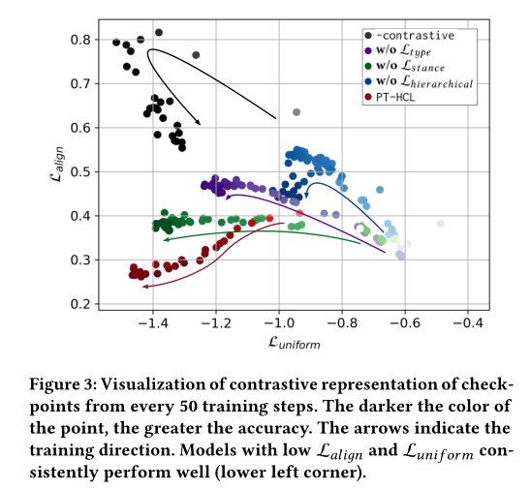
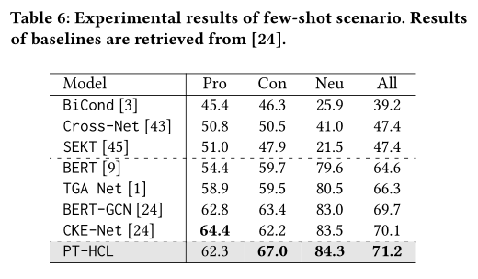
Experiments

Slide 12
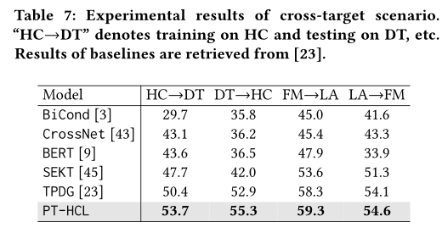
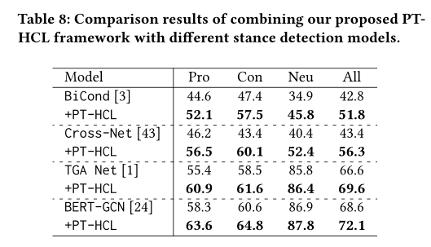
Experiments

Slide 13
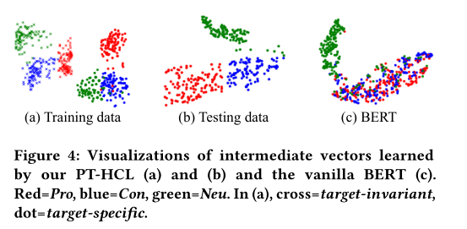
Experiments

Slide 14
Thank you！

